Slide 1
Guide to Computer Forensics and Investigations
Third Edition
Chapter 12
E-mail Investigations

Slide 2
Objectives
Explain the role of e-mail in investigations
Describe client and server roles in e-mail
Describe tasks in investigating e-mail crimes and violations
Explain the use of e-mail server logs
Describe some available e-mail computer forensics tools
Guide to Computer Forensics and Investigations

Slide 3
Exploring the Role of E-mail in Investigations
With the increase in e-mail scams and fraud attempts with phishing or spoofing
  Investigators need to know how to examine and interpret the unique content of e-mail messages
Phishing e-mails are in HTML format
  Which allows creating links to text on a Web page
One of the most noteworthy e-mail scams was 419, or the Nigerian Scam
Spoofing e-mail can be used to commit fraud
Guide to Computer Forensics and Investigations

Slide 4
Exploring the Roles of the Client and Server in E-mail
Send and receive e-mail in two environments
  Internet
  Controlled LAN, MAN, or WAN
Client/server architecture
  Server OS and e-mail software differs from those on the client side
Protected accounts
  Require usernames and passwords
Guide to Computer Forensics and Investigations

Slide 5
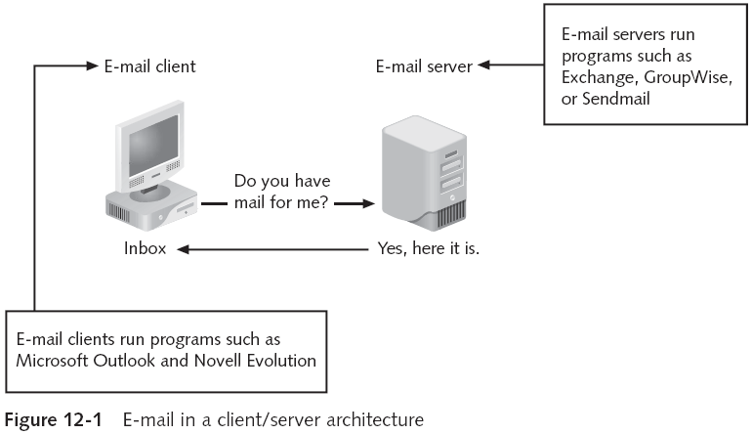
Exploring the Roles of the Client and Server in E-mail (continued)
Guide to Computer Forensics and Investigations

Slide 6
Exploring the Roles of the Client and Server in E-mail (continued)
Name conventions
  Corporate: john.smith@somecompany.com
  Public: whatever@hotmail.com
  Everything after @ belongs to the domain name
Tracing corporate e-mails is easier
  Because accounts use standard names the administrator establishes
Guide to Computer Forensics and Investigations

Slide 7
Investigating E-mail Crimes and Violations
Similar to other types of investigations
Goals
  Find who is behind the crime
  Collect the evidence
  Present your findings
  Build a case
Guide to Computer Forensics and Investigations

Slide 8
Investigating E-mail Crimes and Violations (continued)
Depend on the city, state, or country
  Example: spam
  Always consult with an attorney
Becoming commonplace
Examples of crimes involving e-mails
  Narcotics trafficking
  Extortion
  Sexual harassment
  Child abductions and pornography
Guide to Computer Forensics and Investigations

Slide 9
Examining E-mail Messages
Access victim’s computer to recover the evidence
Using the victim’s e-mail client
  Find and copy evidence in the e-mail
  Access protected or encrypted material
  Print e-mails
Guide victim on the phone
  Open and copy e-mail including headers
Sometimes you will deal with deleted e-mails
Guide to Computer Forensics and Investigations

Slide 10
Examining E-mail Messages (continued)
Copying an e-mail message
  Before you start an e-mail investigation
    You need to copy and print the e-mail involved in the crime or policy violation
  You might also want to forward the message as an attachment to another e-mail address
With many GUI e-mail programs, you can copy an e-mail by dragging it to a storage medium
  Or by saving it in a different location
Guide to Computer Forensics and Investigations

Slide 11
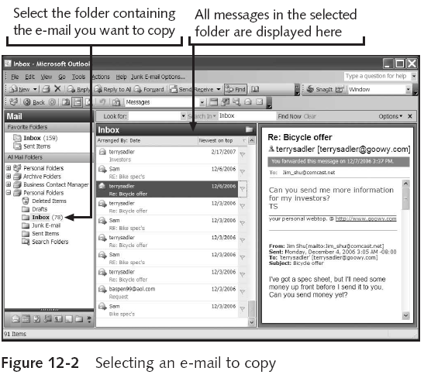
Examining E-mail Messages (continued)
Guide to Computer Forensics and Investigations

Slide 12
Viewing E-mail Headers
Learn how to find e-mail headers
  GUI clients
  Command-line clients
  Web-based clients
After you open e-mail headers, copy and paste them into a text document
  So that you can read them with a text editor
Headers contain useful information
  Unique identifying numbers, IP address of sending server, and sending time
Guide to Computer Forensics and Investigations

Slide 13
Viewing E-mail Headers (continued)
Outlook
  Open the Message Options dialog box
  Copy headers
  Paste them to any text editor
Outlook Express
  Open the message Properties dialog box
  Select Message Source
  Copy and paste the headers to any text editor
Guide to Computer Forensics and Investigations

Slide 14
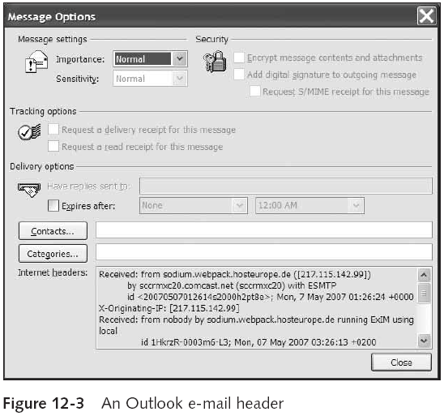
Viewing E-mail Headers (continued)
Guide to Computer Forensics and Investigations

Slide 15
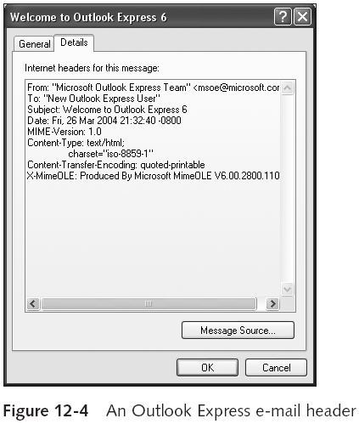
Viewing E-mail Headers (continued)
Guide to Computer Forensics and Investigations

Slide 16
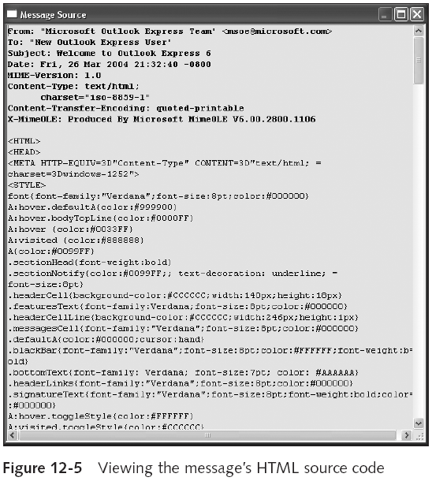
Guide to Computer Forensics and Investigations

Slide 17
Viewing E-mail Headers (continued)
Novell Evolution
  Click View, All Message Headers
  Copy and paste the e-mail header
Pine and ELM
  Check enable-full-headers
AOL headers
  Click Action, View Message Source
  Copy and paste headers
Guide to Computer Forensics and Investigations

Slide 18
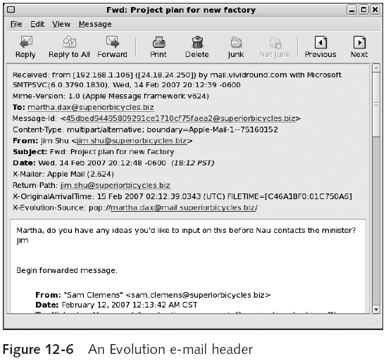
Viewing E-mail Headers (continued)
Guide to Computer Forensics and Investigations

Slide 19
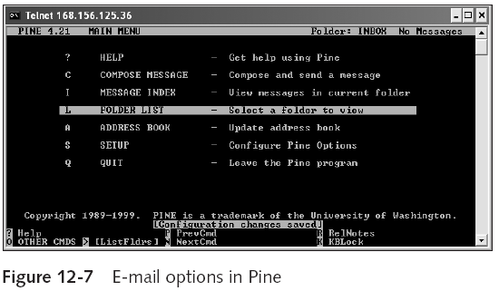
Viewing E-mail Headers (continued)
Guide to Computer Forensics and Investigations

Slide 20
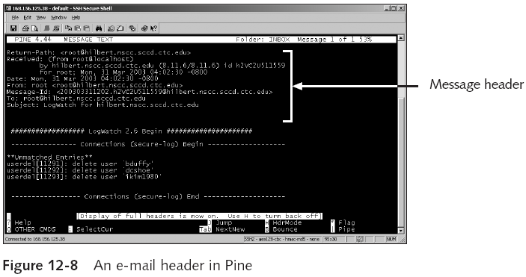
Viewing E-mail Headers (continued)
Guide to Computer Forensics and Investigations

Slide 21
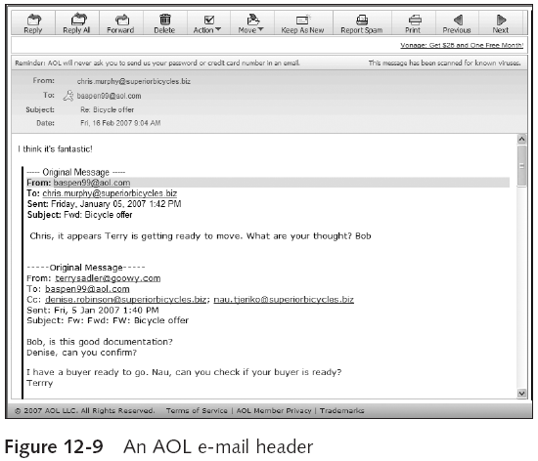
Viewing E-mail Headers (continued)
Guide to Computer Forensics and Investigations

Slide 22
Viewing E-mail Headers (continued)
Hotmail
  Click Options, and then click the Mail Display Settings
  Click the Advanced option button under Message Headers
  Copy and paste headers
Apple Mail
  Click View from the menu, point to Message, and then click Long Header
  Copy and paste headers
Guide to Computer Forensics and Investigations

Slide 23
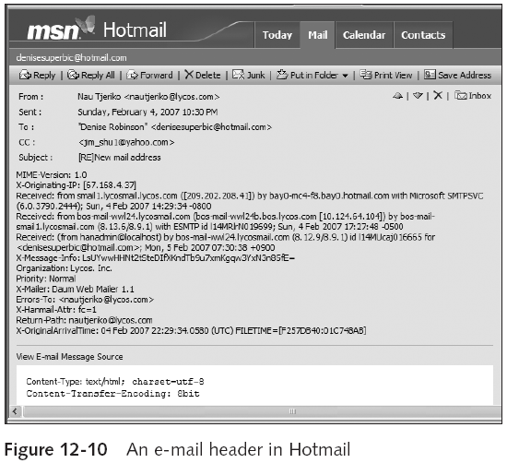
Viewing E-mail Headers (continued)
Guide to Computer Forensics and Investigations

Slide 24
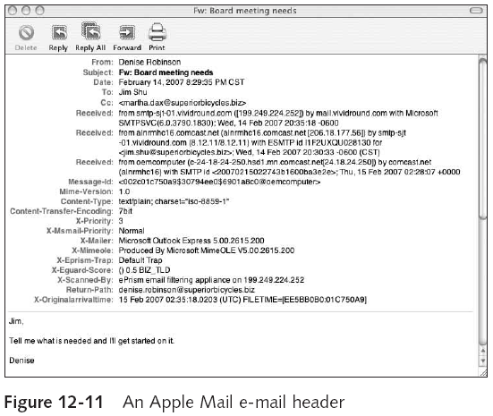
Viewing E-mail Headers (continued)
Guide to Computer Forensics and Investigations

Slide 25
Viewing E-mail Headers (continued)
Yahoo
  Click Mail Options
  Click General Preferences and Show All headers on incoming messages
  Copy and paste headers
Guide to Computer Forensics and Investigations

Slide 26
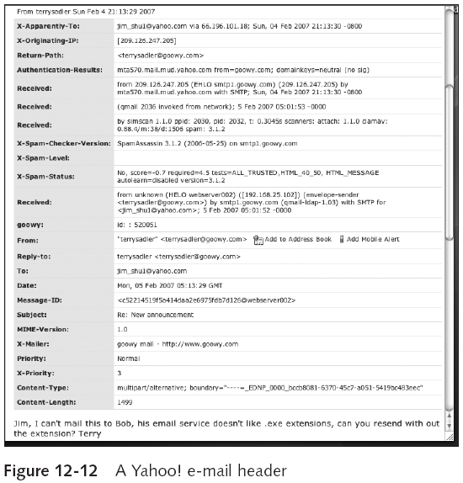
Guide to Computer Forensics and Investigations

Slide 27
Examining E-mail Headers
Gather supporting evidence and track suspect
  Return path
  Recipient’s e-mail address
  Type of sending e-mail service
  IP address of sending server
  Name of the e-mail server
  Unique message number
  Date and time e-mail was sent
  Attachment files information
Guide to Computer Forensics and Investigations

Slide 28
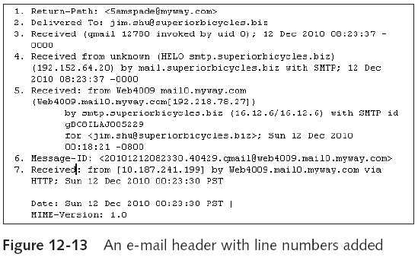
Examining E-mail Headers (continued)
Guide to Computer Forensics and Investigations

Slide 29
Examining Additional E-mail Files
E-mail messages are saved on the client side or left at the server
Microsoft Outlook uses .pst and .ost files
Most e-mail programs also include an electronic address book
In Web-based e-mail
  Messages are displayed and saved as Web pages in the browser’s cache folders
  Many Web-based e-mail providers also offer instant messaging (IM) services
Guide to Computer Forensics and Investigations

Slide 30
Tracing an E-mail Message
Contact the administrator responsible for the sending server
Finding domain name’s point of contact
  www.arin.net
  www.internic.com
  www.freeality.com
  www.google.com
Find suspect’s contact information
Verify your findings by checking network e-mail logs against e-mail addresses
Guide to Computer Forensics and Investigations

Slide 31
Using Network E-mail Logs
Router logs
  Record all incoming and outgoing traffic
  Have rules to allow or disallow traffic
  You can resolve the path a transmitted e-mail has taken
Firewall logs
  Filter e-mail traffic
  Verify whether the e-mail passed through
You can use any text editor or specialized tools
Guide to Computer Forensics and Investigations

Slide 32
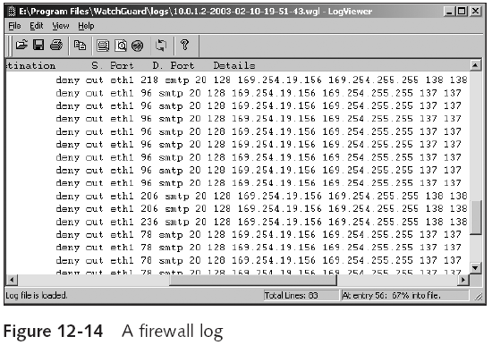
Using Network E-mail Logs (continued)
Guide to Computer Forensics and Investigations

Slide 33
Understanding E-mail Servers
Computer loaded with software that uses e-mail protocols for its services
  And maintains logs you can examine and use in your investigation
E-mail storage
  Database
  Flat file
Logs
  Default or manual
  Continuous and circular
Guide to Computer Forensics and Investigations

Slide 34
Understanding E-mail Servers (continued)
Log information
  E-mail content
  Sending IP address
  Receiving and reading date and time
  System-specific information
Contact suspect’s network e-mail administrator as soon as possible
Servers can recover deleted e-mails
  Similar to deletion of files on a hard drive
Guide to Computer Forensics and Investigations

Slide 35
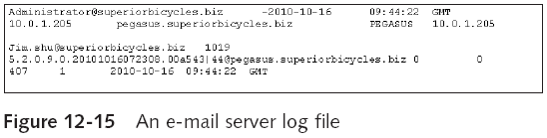
Understanding E-mail Servers (continued)
Guide to Computer Forensics and Investigations

Slide 36
Examining UNIX E-mail Server Logs
/etc/sendmail.cf
  Configuration information for Sendmail
/etc/syslog.conf
  Specifies how and which events Sendmail logs
/var/log/maillog
  SMTP and POP3 communications
    IP address and time stamp
Check UNIX man pages for more information
Guide to Computer Forensics and Investigations

Slide 37
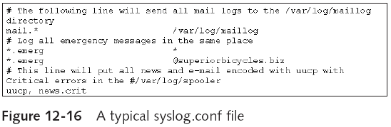
Examining UNIX E-mail Server Logs (continued)
Guide to Computer Forensics and Investigations

Slide 38
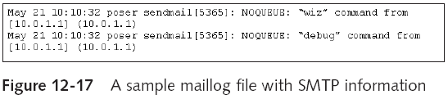
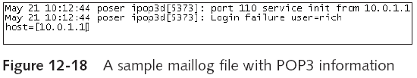
Examining UNIX E-mail Server Logs (continued)
Guide to Computer Forensics and Investigations

Slide 39
Examining Microsoft E-mail Server Logs
Microsoft Exchange Server (Exchange)
  Uses a database
  Based on Microsoft Extensible Storage Engine
Information Store files
  Database files *.edb
    Responsible for MAPI information
  Database files *.stm
    Responsible for non-MAPI information
Guide to Computer Forensics and Investigations

Slide 40
Examining Microsoft E-mail Server Logs (continued)
Transaction logs
  Keep track of e-mail databases
Checkpoints
  Keep track of transaction logs
Temporary files
E-mail communication logs
  res#.log
Tracking.log
  Tracks messages
Guide to Computer Forensics and Investigations

Slide 41
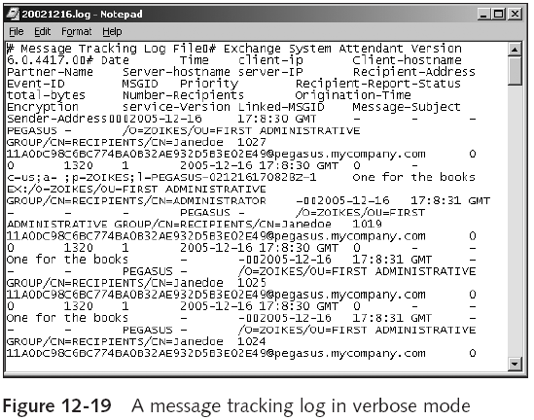
Examining Microsoft E-mail Server Logs (continued)
Guide to Computer Forensics and Investigations

Slide 42
Examining Microsoft E-mail Server Logs (continued)
Troubleshooting or diagnostic log
  Logs events
  Use Windows Event Viewer
  Open the Event Properties dialog box for more details about an event
Guide to Computer Forensics and Investigations

Slide 43
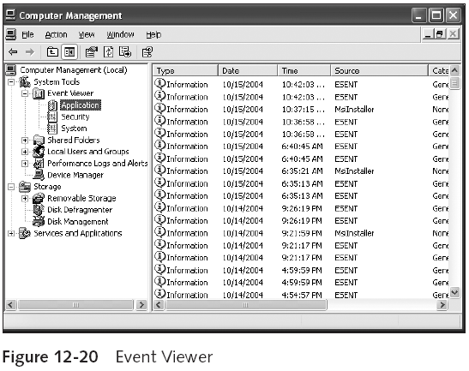
Examining Microsoft E-mail Server Logs (continued)
Guide to Computer Forensics and Investigations

Slide 44
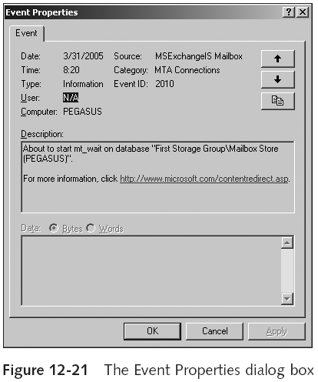
Examining Microsoft E-mail Server Logs (continued)
Guide to Computer Forensics and Investigations

Slide 45
Examining Novell GroupWise E-mail Logs
Up to 25 databases for e-mail users
  Stored on the Ofuser directory object
  Referenced by a username, an unique identifier, and .db extension
Shares resources with e-mail server databases
Mailboxes organizations
  Permanent index files
  QuickFinder
Guide to Computer Forensics and Investigations

Slide 46
Examining Novell GroupWise E-mail Logs (continued)
Folder and file structure can be complex
  It uses Novell directory structure
Guardian
  Directory of every database
  Tracks changes in the GroupWise environment
  Considered a single point of failure
Log files
  GroupWise generates log files (.log extension) maintained in a standard log format in GroupWise folders
Guide to Computer Forensics and Investigations

Slide 47
Using Specialized E-mail Forensics Tools
Tools include:
  AccessData’s Forensic Toolkit (FTK)
  ProDiscover Basic
  FINALeMAIL
  Sawmill-GroupWise
  DBXtract
  Fookes Aid4Mail and MailBag Assistant
  Paraben E-Mail Examiner
  Ontrack Easy Recovery EmailRepair
  R-Tools R-Mail
Guide to Computer Forensics and Investigations

Slide 48
Using Specialized E-mail Forensics Tools (continued)
Tools allow you to find:
  E-mail database files
  Personal e-mail files
  Offline storage files
  Log files
Advantage
  Do not need to know how e-mail servers and clients work
Guide to Computer Forensics and Investigations

Slide 49
Using Specialized E-mail Forensics Tools (continued)
FINALeMAIL
  Scans e-mail database files
  Recovers deleted e-mails
  Searches computer for other files associated with e-mail
Guide to Computer Forensics and Investigations

Slide 50
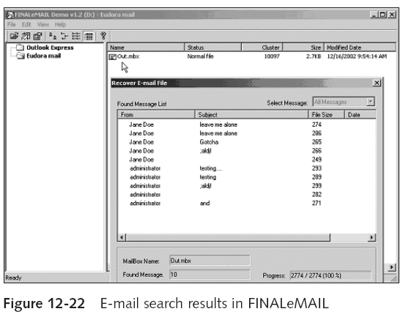
Using Specialized E-mail Forensics Tools (continued)
Guide to Computer Forensics and Investigations

Slide 51
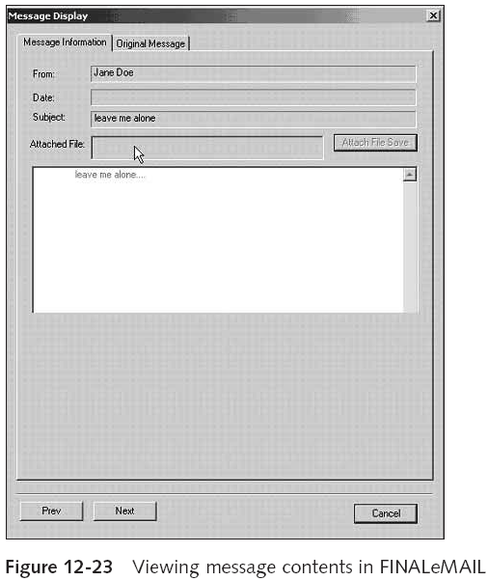
Guide to Computer Forensics and Investigations

Slide 52
Using AccessData FTK to Recover
E-mail
FTK
  Can index data on a disk image or an entire drive for faster data retrieval
  Filters and finds files specific to e-mail clients and servers
To recover e-mail from Outlook and Outlook Express
  AccessData integrated dtSearch
    dtSearch builds a b-tree index of all text data in a drive, an image file, or a group of files
Guide to Computer Forensics and Investigations

Slide 53
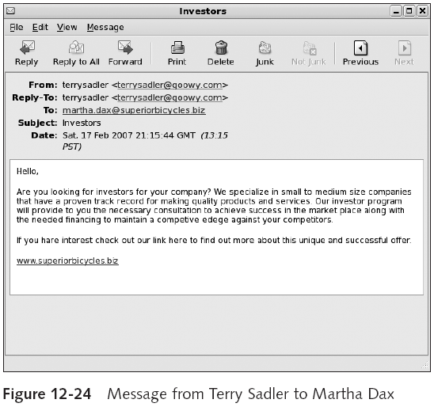
Guide to Computer Forensics and Investigations

Slide 54
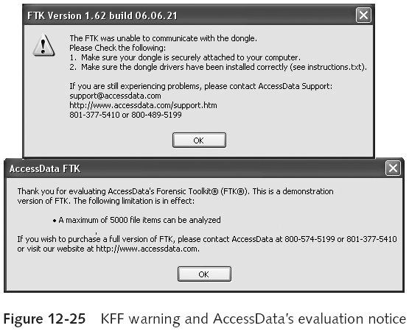
Using AccessData FTK to Recover
E-mail (continued)
Guide to Computer Forensics and Investigations

Slide 55
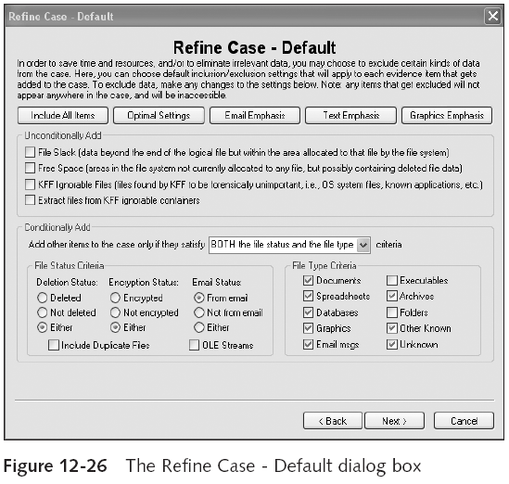
Guide to Computer Forensics and Investigations

Slide 56
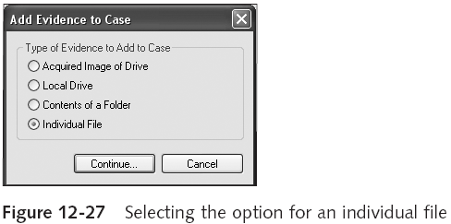
Using AccessData FTK to Recover
E-mail (continued)
Guide to Computer Forensics and Investigations

Slide 57
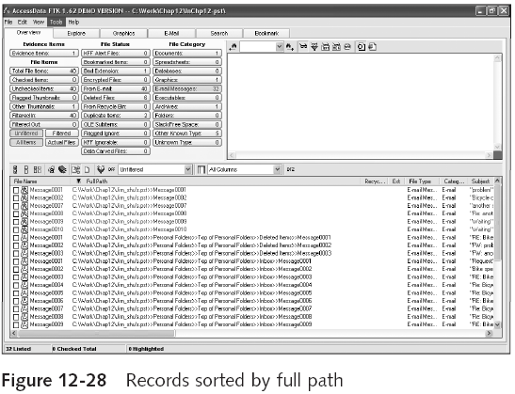
Using AccessData FTK to Recover
E-mail (continued)
Guide to Computer Forensics and Investigations

Slide 58
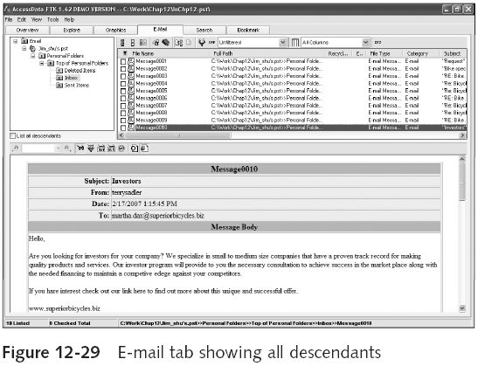
Using AccessData FTK to Recover
E-mail (continued)
Guide to Computer Forensics and Investigations

Slide 59
Using a Hexadecimal Editor to Carve E-mail Messages
Very few vendors have products for analyzing e-mail in systems other than Microsoft
mbox format
  Stores e-mails in flat plaintext files
Multipurpose Internet Mail Extensions (MIME) format
  Used by vendor-unique e-mail file systems, such as Microsoft .pst or .ost
Example: carve e-mail messages from Evolution
Guide to Computer Forensics and Investigations

Slide 60
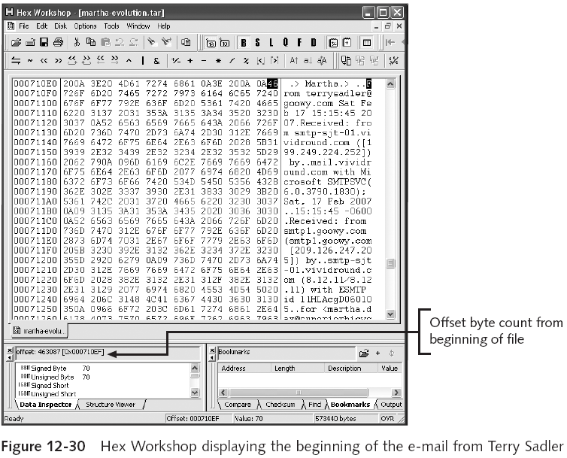
Guide to Computer Forensics and Investigations

Slide 61
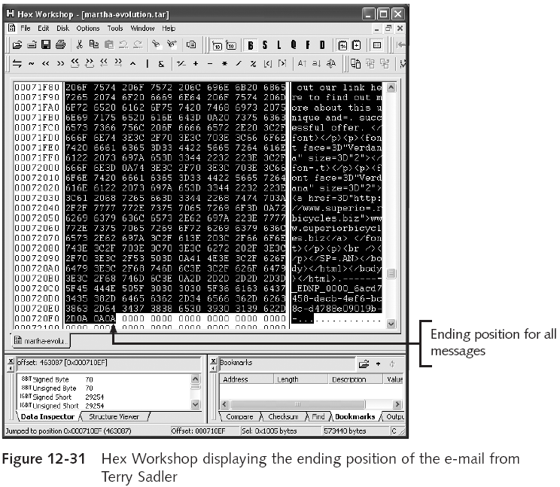
Guide to Computer Forensics and Investigations

Slide 62
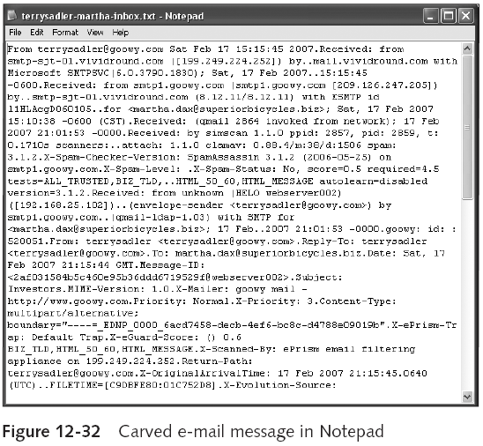
Using a Hexadecimal Editor to Carve E-mail Messages (continued)
Guide to Computer Forensics and Investigations

Slide 63
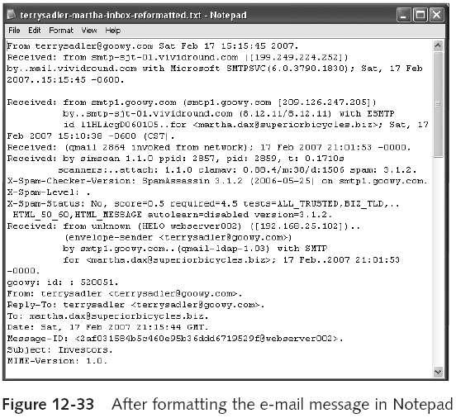
Using a Hexadecimal Editor to Carve E-mail Messages (continued)
Guide to Computer Forensics and Investigations

Slide 64
Summary
E-mail fraudsters use phishing and spoofing scam techniques
Send and receive e-mail via Internet or a LAN
  Both environments use client/server architecture
E-mail investigations are similar to other kinds of investigations
Access victim’s computer to recover evidence
  Copy and print the e-mail message involved in the crime or policy violation
Find e-mail headers
Guide to Computer Forensics and Investigations

Slide 65
Summary (continued)
Investigating e-mail abuse
  Be familiar with e-mail servers and clients’ operations
Check
  E-mail message files, headers, and server log files
Currently, only a few forensics tools can recover deleted Outlook and Outlook Express messages
For e-mail applications that use the mbox format, a hexadecimal editor can be used to carve messages manually
Guide to Computer Forensics and Investigations

